Slide 1


OWASP Top 10 Review
Kenneth Marshall-Junior Software Developer

Slide 2

What is OWASP?
Open Web Application Security Project(OWASP)
Non-Profit Organization founded by Mark Curphey in 2001
Key Aim: To raise awareness about application security by identifying some of the most critical security risks facing organizations.
Many standards, books, tools, and organizations reference the Top 10 project, including MITRE and the FTC.

Slide 3


THE OWASP TOP 10 PROJECT
The OWASP Top 10 is a standard awareness document for developers and web application security. It represents a broad consensus about the most critical security risks to web applications

Slide 4
Injection
Broken Authentication
Sensitive Data Exposure
XML External Entities (XXE)
Broken Access Control
Security Misconfiguration
Cross-Site Scripting (XSS)
Insecure Deserialization
Using Components with Known Vulnerabilities
Insufficient Logging & Monitoring

Slide 5
Injection
What is it?
Almost ANY source of data can be an injection vector, environment variables, parameters, external and internal web services, and all types of users. Injection flaws occur when an attacker can send hostile data to an interpreter( JavaScript, Perl, Python, BASIC).

Slide 6
Examples of Injection
SQL Injection
OS Commands
NoSQL Queries
LDAP Injection (Lightweight Data Directory Access Protocol)
SQL Injection
SQL injection usually occurs when you ask a user for input, like their username/userid, and instead of a name/id, the user gives you an SQL statement that you will unknowingly run on your database.

Slide 7


Intended Code
Form of Injection(User Input)
And because 1=1 results to TRUE
SQL Statement
This will return all rows from the Users Table, which is a breach of intended us for this code.

Slide 8

Prevention
The preferred option is to use a safe API, which avoids the use of the interpreter entirely or provides a parameterized interface, or migrate to use Object Relational Mapping Tools (ORMs).
Use LIMIT and other SQL controls within queries to prevent mass disclosure of records in case of SQL injection.
Apply Input Validation (using "allow list" approach) combined with Output Sanitizing+Escaping on user input/output.

Slide 9
Broken Authentication
What is it?
Credential stuffing, the use of lists of known passwords, is a common attack.
Continued use of passwords as a sole factor.
Application session timeouts aren’t set properly. A user uses a public computer to access an application. Instead of selecting “logout” the user simply closes the browser tab and walks away. An attacker uses the same browser an hour later, and the user is still authenticated.

Slide 10
Examples of Broken Authentication
Credential Stuffing
Using the same password to often or using common passwords ex. “Password123”
Improper session timeout handling
Application has missing or ineffective multi-factor authentication
Credential Stuffing
Credential stuffing is a type of cyberattack in which stolen account credentials, typically consisting of lists of usernames and/or email addresses and the corresponding passwords (often from a data breach).
The attacker simply automates the logins for a large number (thousands to millions) of previously discovered credential pairs using standard web automation tools such as Selenium, cURL, PhantomJS

Slide 11
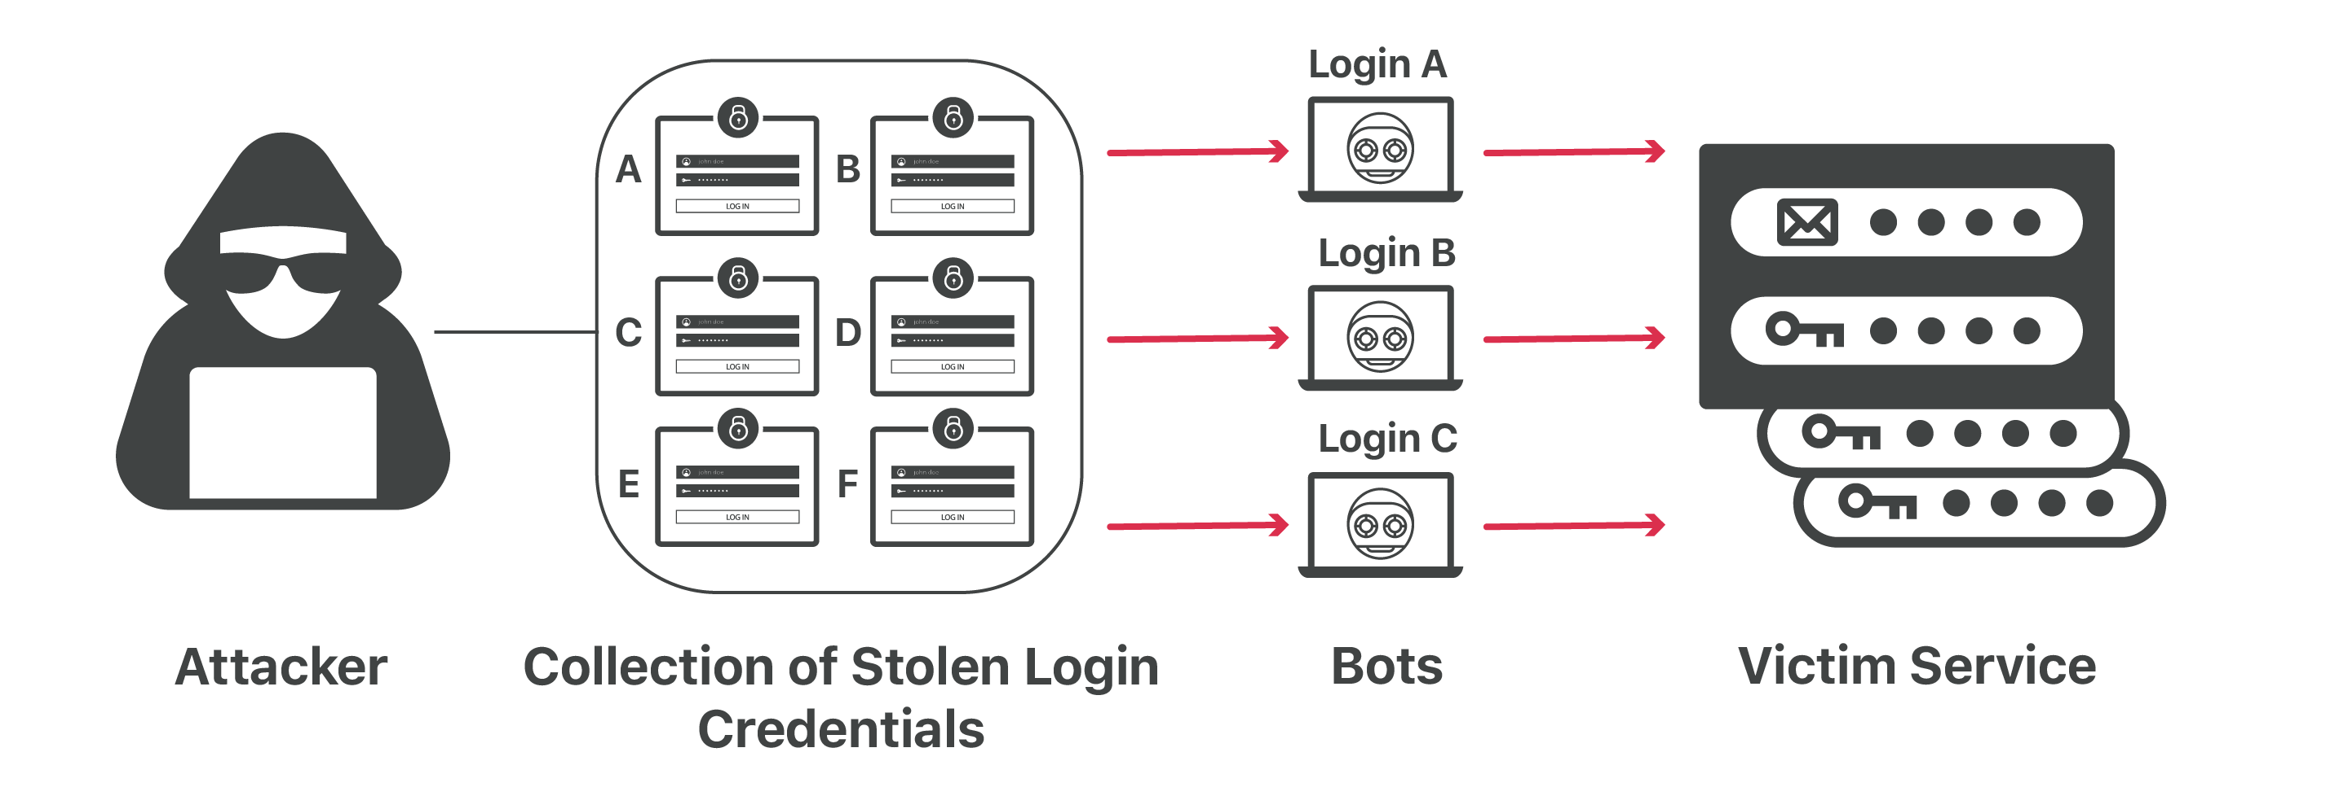

Slide 12
Notable Breaches
Below are excerpts taken from publications analyzing large-scale breaches. Evidence supports that these breaches were the result of credential stuffing.
Sony, 2011 breach: “I wish to highlight that two-thirds of users whose data were in both the Sony data set and the Gawker breach earlier this year used the same password for each system.”
Source: Agile Bits 1 - Source: Wired 2
Yahoo, 2012 breach: “What do Sony and Yahoo! have in common? Passwords!”.
Source: Troy Hunt. 3
Dropbox, 2012 breach: “The usernames and passwords referenced in these articles were stolen from unrelated services, not Dropbox. Attackers then used these stolen credentials to try to log in to sites across the internet, including Dropbox”.
Source: Dropbox. 4

Slide 13

Prevention
Use MFA(Multi-Factor Authentication)-is granted access to a website or application only after successfully presenting two or more pieces of evidence
Memorized Secret Authenticators- is a secret value intended to be chosen and memorized by the user. Memorized secrets need to be of sufficient complexity and secrecy that it would be impractical for an attacker to guess or otherwise discover the correct secret value. A memorized secret is something you and only you should know.
Implement weak-password checks, such as testing new or changed passwords against a list of the top 10000 worst passwords

Slide 14
Sensitive Data Exposure
What is it?
Many web applications and APIs do not properly protect sensitive data, such as financial, healthcare, and PII(Personally identifiable information).
Sensitive data may be compromised without extra protection, such as encryption at rest or in transit, and requires special precautions when exchanged with the browser.

Slide 15
Examples of Sensitive Data Exposure
Clear Text Exposure- happens when data is automatically decrypted when retrieved by server from front-end ---leaving sensitive information exposed.
An application that uses unsalted or simple hashing algorithms to store passwords.
Simply not encrypting sensitive data at all.
Lack of HSTS(HTTP Strict Transport Security)
A site doesn’t use or enforce TLS(Transport Layer Security) for all pages or supports weak encryption. An attacker monitors network traffic (e.g. at an insecure wireless network), downgrades connections from HTTPS to HTTP, intercepts requests, and steals the user’s session cookie. The attacker then replays this cookie and hijacks the user’s (authenticated) session, accessing or modifying the user’s private data.

Slide 16
Prevention
Use HSTS(HTTP Strict Transport Security) directives.
Make sure to encrypt all sensitive data at rest. (hashing
Ensure up-to-date and strong standard algorithms, protocols, and keys are in place; use proper key management.
Disable caching for response that contain sensitive data
Use Hashing techniques over Encryption when possible, Encryption is a two-way function; what is encrypted can be decrypted with the proper key. Hashing, however, is a one-way function that scrambles plain text to produce a unique message digest
Don’t store sensitive data unnecessarily.

Slide 17
XML External Entities(XXE)
What is it?
XXE is a type of attack that abuses a widely available but rarely used feature of XML parsers.
By default, many older XML processors allow specification of an external entity, a URI that is dereferenced and evaluated during XML processing.

Slide 18
Examples of XXE
The “Billon Laughs Attack”-a type of DoS(Denial of Service) Attack, this is an attack by including a potentially endless file.
An attacker probes the server’s private network by changing the ENTITY line of an XML file. Type of Injection Attack
XXE attacks can be used to perform server-side request forgery (SSRF). This is a potentially serious vulnerability in which the server-side application can be induced to make HTTP requests to any URL that the server can access

Slide 19
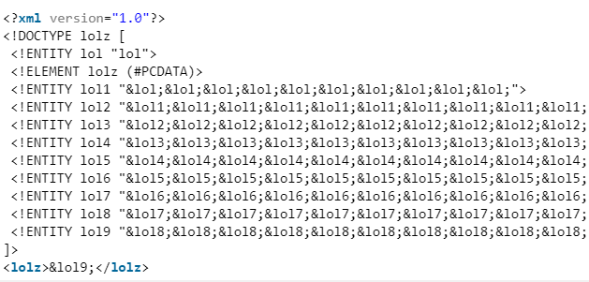
Billion Laughs Attack Example
By parsing this message, the entity &z; is recursively resolved, which leads to high memory consumption
Because of this high consumption memory of memory the request is thereby denied by the server

Slide 20

Prevention
Whenever possible, use less complex data formats such as JSON, and avoiding serialization of sensitive data
Verify that XML or XSL file upload functionality validates incoming XML using XSD validation or similar.
Disable XML external entity and DTD processing in all XML parsers in the application, as per the OWASP Cheat Sheet ‘XXE Prevention’
If these controls are not possible, consider using virtual patching, API security gateways, or Web Application Firewalls (WAFs) to detect, monitor, and block XXE attacks

Slide 21
Broken Access Control
What is it?
Access control enforces policy such that users cannot act outside of their intended permissions. Failures typically lead to unauthorized information disclosure, modification or destruction of all data, or performing a business function outside of the limits of the user.

Slide 22
Examples of Broken Access Control
Bypassing access control checks by modifying the URL, internal application state, or the HTML page, or simply using a custom API attack tool.
Allowing the primary key to be changed to another’s users record, permitting viewing or editing someone else’s account.
Elevation of privilege. Acting as a user without being logged in, or acting as an admin when logged in as a user.
CORS(Cross-Origin Resource Sharing) misconfiguration allows unauthorized API access

Slide 23

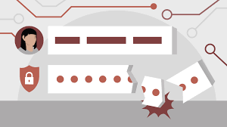
The application uses unverified data in a SQL call that is accessing account information.
In this case the attacker would simply need to modify the “acct” variable to access all information from this statement’s resultSet.

Slide 24
Prevention
Access control is only effective if enforced in trusted server-side code or server-less API, where the attacker cannot modify the access control check or metadata.
With the exception of public resources, deny by default.
Log access control failures, alert admins when appropriate (e.g. repeated failures).

Slide 25
Security Misconfiguration
What is it?
The exploitation of unpatched flaws or access default accounts, unused pages, unprotected files and directories, etc. to gain unauthorized access or knowledge of the system
Misconfiguration happens at every level of an application(Front-end/Back-end)

Slide 26
Examples of Security Misconfiguration
improperly configured security permissions
Commissioning an application server into production with test applications still enabled that have not been removed. If these test application have admin privileges and are accessed by an attacker the entire server would be exposed.
The application server’s configuration allows detailed error messages, e.g. stack traces, to be returned to users. These messages could potentially expose sensitive data that isn’t intended for user consumption.

Slide 27
Prevention
Remove or do not install unused features and frameworks.
Using proper HTTP response headers that are displayed to end-user when server-side errors occur.
repeatable hardening process that makes it fast and easy to deploy another environment that is properly locked down. Development, QA, and production environments should all be configured identically, with different credentials used in each environment.

Slide 28
Cross-Site Scripting (XSS)
What is it?
Reflected XSS-Reflected attacks are those where the injected script is reflected off the web server, such as in an error message, search result, or any other response that includes some or all the input sent to the server as part of the request
DOM XSS-JavaScript frameworks, single-page applications, and APIs that dynamically include attacker-controllable data to a page are vulnerable to DOM XSS.
Stored XSS- stores unsanitized user input that is viewed later by another user.

Slide 29
Examples of XSS
When a user is tricked into clicking on a malicious link, submitting a specially crafted form, or even just browsing to a malicious site, the injected code travels to the vulnerable web site, which reflects the attack back to the user’s browser.
The most severe XSS attacks involve disclosure of the user’s session cookie, allowing an attacker to hijack the user’s session and take over the account
Redirecting the victim to web content controlled by the attacker

Slide 30
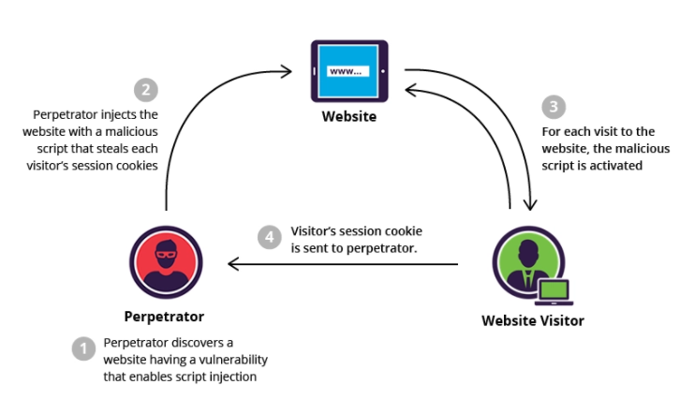

Slide 31
Prevention
Best practice is to deny all - don't put untrusted data into your HTML or JS documents
If you must input untrusted sources into your code---Most web frameworks have a method for HTML encoding/escaping for the characters
Enabling a Content Security Policy (CSP) as a defense-in-depth mitigating control against XSS.

Slide 32
Insecure Deserialization
What is it?
Object and data structure related attacks where the attacker modifies application logic or achieves arbitrary remote code execution if there are classes available to the application that can change behavior during or after deserialization.
Serialization is the process of turning some object into a data format that can be restored later.
Deserialization is the reverse of that process.

Slide 33
Example of Insecure Deserialization
A PHP forum uses PHP object serialization to save a “super” cookie, containing the user’s user ID, role, password hash, and other state:
a:4:{i:0;i:132;i:1;s:7:"Mallory";i:2;s:4:"user";
i:3;s:32:"b6a8b3bea87fe0e05022f8f3c88bc960";}
An attacker changes the serialized object to give themselves admin privileges
:a:4:{i:0;i:1;i:1;s:5:"Alice";i:2;s:5:"admin";
i:3;s:32:"b6a8b3bea87fe0e05022f8f3c88bc960";}

Slide 34
Prevention
Do not to accept serialized objects from untrusted sources
Implementing integrity checks such as digital signatures on any serialized objects
If the application knows before deserialization which messages will need to be processed, they could sign them as part of the serialization process. The application could then to choose not to deserialize any message which didn't have an authenticated signature.

Slide 35
Using Components with Known Vulnerabilities
What is it?
This is in relation to out-of-date dependencies, unrealized component versions and unsupported applications.

Slide 36
Examples of Using Components with Unknown Vulnerabilities
Unaware of which component versions a software is running
Application is out-of-date and no longer offers customer support that could address any issues with application
Not scanning for vulnerabilities regularly throughout your application
Component-heavy development patterns can lead to development teams not even understanding which components they use in their application or API, this can easily lead to components becoming out-of-date without a developer being aware.

Slide 37

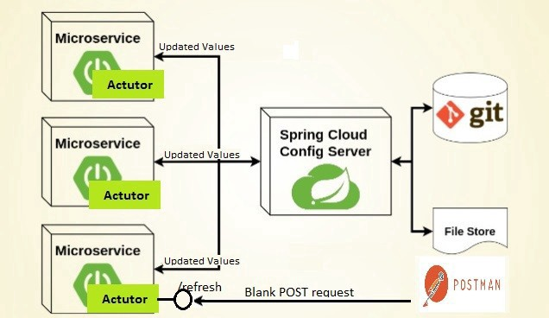
Continuously inventory the versions of both client-side and server-side components (e.g., frameworks, libraries) and their dependencies using tools like versions, DependencyCheck, retire.js, etc.
Only obtain components from official sources over secure links. Prefer signed packages to reduce the chance of including a modified, malicious component.
Every organization must ensure that there is an ongoing plan for monitoring, triaging, and applying updates or configuration changes for the lifetime of the application or portfolio
Using Centralized Configuration Services like Spring Cloud etc.

Slide 38
Insufficient Logging and Monitoring
What is it?
Exploitation of insufficient logging and monitoring, this can make malicious behavior more difficult to detect and may hinder forensic analysis after an attack succeeds.
This issue is included in the Top 10 based on an industry survey.
In 2016, identifying a breach took an average of 191 days

Slide 39

Examples of Insufficient Logging and Monitoring
Occurs when the records/logs of applications and APIs are not monitored for suspicious activity.
Logs are only stored locally.
Lacking appropriate alerting thresholds and response escalation processes.
Admin interface does not log failed authentication attempts, making it easier for attackers to perform brute force password guessing without being detected.

Slide 40
Use sufficient logging and monitoring tools like Log4j. Ensure that these tools support multiple levels of detail
Logging failed authentication attempts can warn admin of potential brute force attacks
Establish effective monitoring and alerting system, so that causes of concern do not go unnoticed .
Establish effective monitoring and alertingEstablish effective monitoring and alerting

Slide 41
Questions?

Slide 42
THANK YOU

